Slide 1

Front End Engineering-I Project
Team Details:
>Gayatri (2410990287)
>Gia Goyal (2410990289)
>Ghantejveer Singh (2410990288)
Faculty Coordinator:
Mrs. Gaganpreet Kaur
:
Chitkara University Institute of Engineering and Technology,
Chitkara University, Punjab

Slide 2

Table of Contents
Introduction
Problem Statement
Technical Details
Key Features
Project Highlights
Bonus Feature(optional)
Conclusion
Future Scope
References/Links used

Slide 3

Introduction
Title of the Project: Music Player
Team Members:
>Gayatri (2410990287)
>Gia Goyal (2410990289)
>Ghantejveer Singh (2410990288)
Overview of the Project:
The Music Player project aims to develop a user-friendly and visually appealing audio player with modern features such as album art display , playlist feature and real-time audio control. The goal is to provide users with an enhanced music listening experience that goes beyond basic playback, integrating interactive controls and sleek design elements. This project combines HTML, CSS, and JavaScript to create a fully functional and stylish music player that caters to the needs of today’s users.

Slide 4

Problem Statement
Problem Statement:
Developing a music player that offers more than just basic playback is challenging due to the need for seamless user interaction, attractive design, and dynamic functionality.
Background Information:
Existing music players often lack user-friendly features such as real-time audio control, and visual enhancements like album art displays.
Project Aim:
The project aims to create a modern, user-friendly music player with intuitive controls and dynamic album art display.

Slide 5
Technical Details
HTML (Hypertext Markup Language): Used to structure the web page, including the layout of the music player, buttons, and album art.
CSS (Cascading Style Sheets): Utilized to style the player interface with modern, sleek design elements, enhancing the visual appeal through colors, fonts, and animations.
JavaScript (JS): Employed for interactive elements, handling audio playback controls, playlist management, and real-time updates like track switching and visual feedback.
Methods: Designed using a modular approach, separating HTML for structure, CSS for styling, and JS for functionality to maintain clean and organized code.
In addition to these we have also used Bootstrap to streamline styling and ensure a responsive design.

Slide 6

Key Features
Interactive Playback Controls:
Includes play, pause, next, and previous buttons, allowing users to control audio playback effortlessly.
Real-Time Progress Bar:
Displays the track’s current position, allowing users to see and adjust the playback timeline.
Responsive Design:
Optimized for various screen sizes, ensuring the player looks great on both desktop and mobile devices.

Slide 7

Project Highlights
The screenshot in the next slide shows our music system project.
The ones that follow contain the html, CSS and java script code used to design it.
We have used Internal CSS using <style>...</style> and Internal ; using <script>...</script> tag.

Slide 8
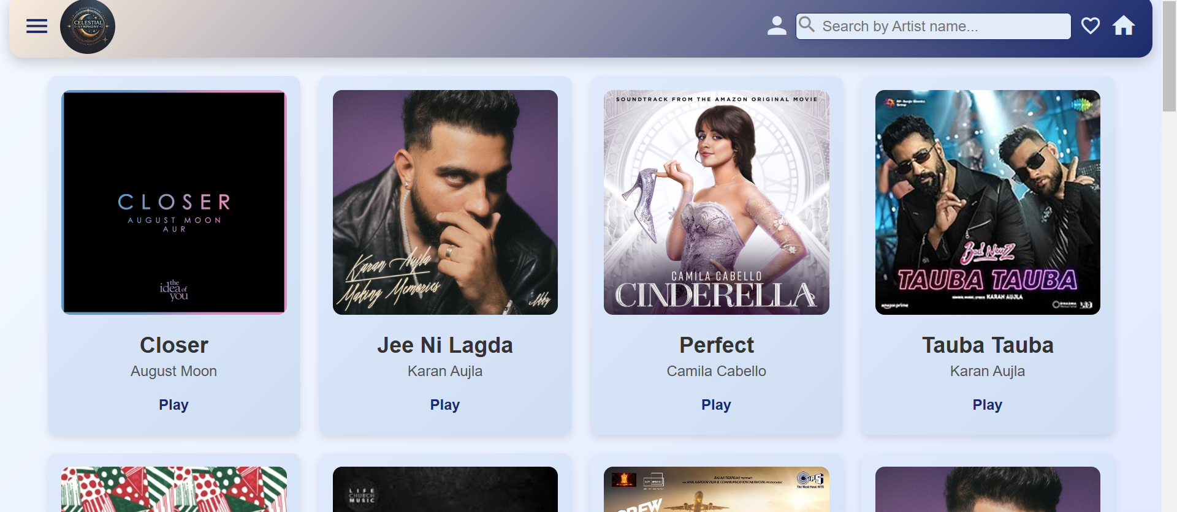

Slide 9
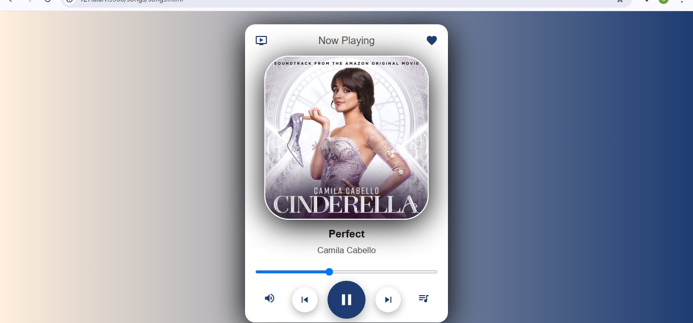

Slide 10
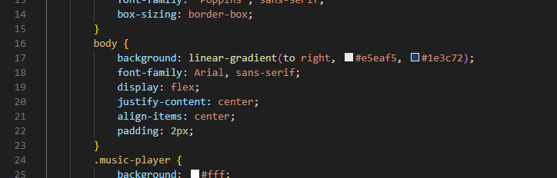
Screenshot 1
Screenshot 1 contains the code snippet that added the gradient background to our web page.

Slide 11
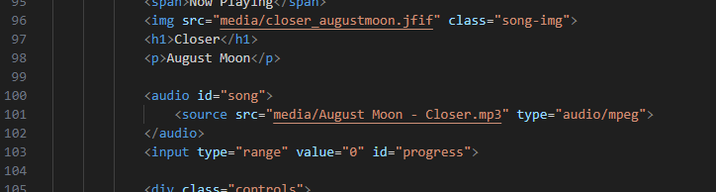
Screenshot 2
Screenshot 2 has the snippet that added the main media song image in the middle.

Slide 12
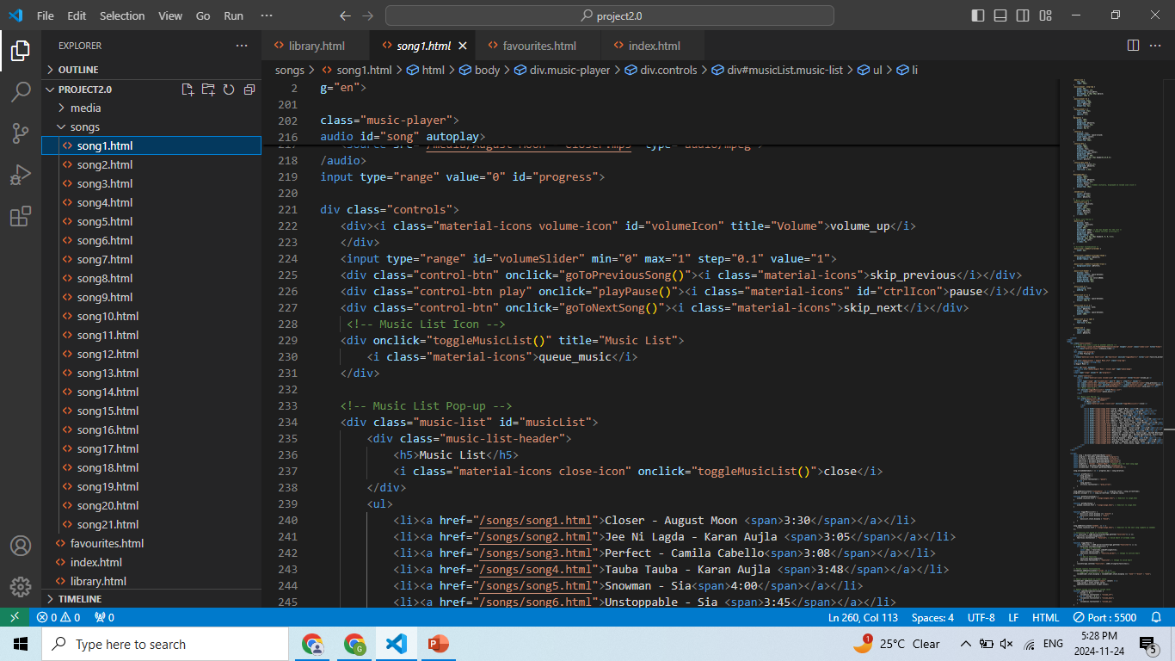
Screenshot 3
Screenshot 3 has the commands that added the play/pause, previous and next buttons.

Slide 13
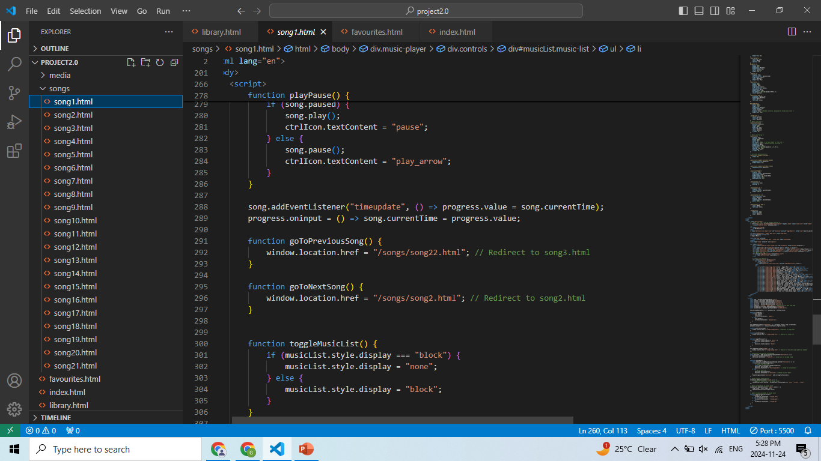
Screenshot 4
Screenshot 4 has the JS commands that made our website responsive.

Slide 14
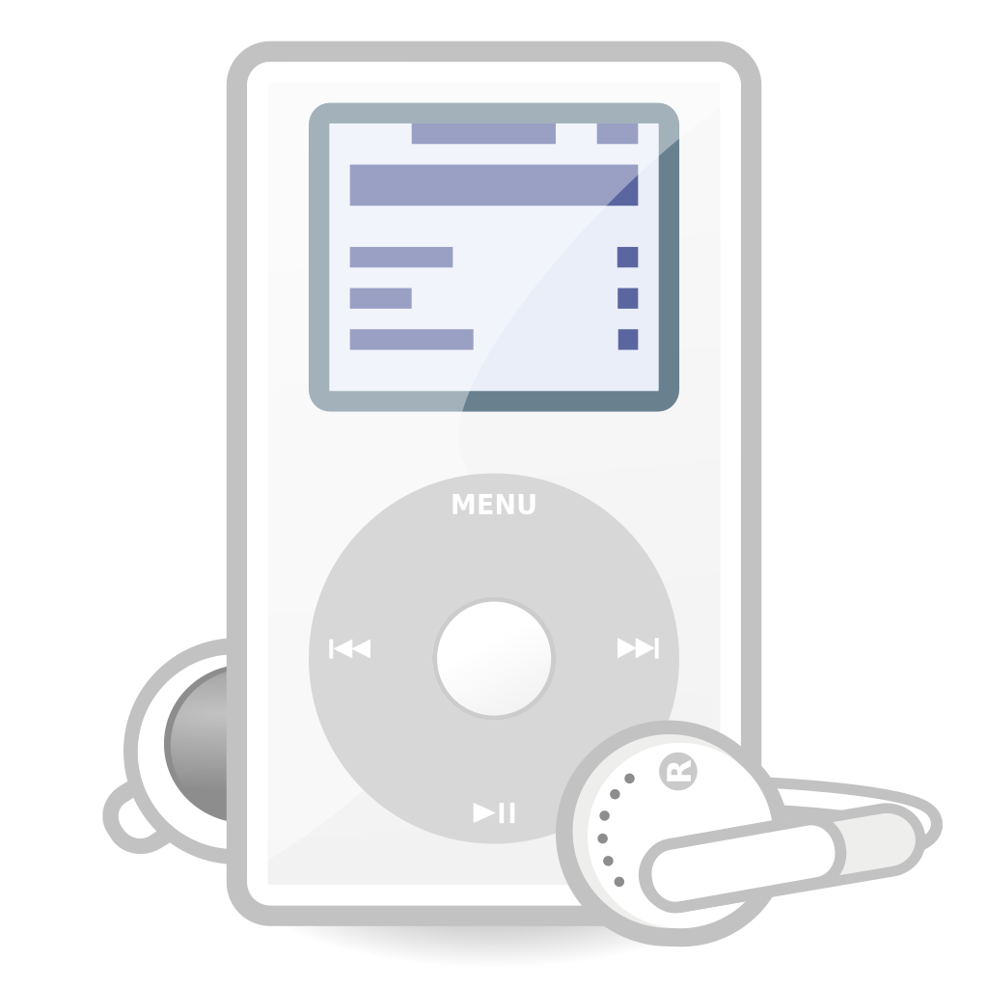
Bonus Features
YouTube Integration:
Links each song to its YouTube video.
Offers a rich audio-visual experience.
Automatic Song Switching:
Automatically switches to the next song when the current one ends.
Enhances user convenience with seamless music playback.
Why These Features Stand Out:
Enhanced User Experience: Visually appealing and intuitive controls keep users engaged.
Automation: Less manual interaction needed, improving overall usability.

Slide 15
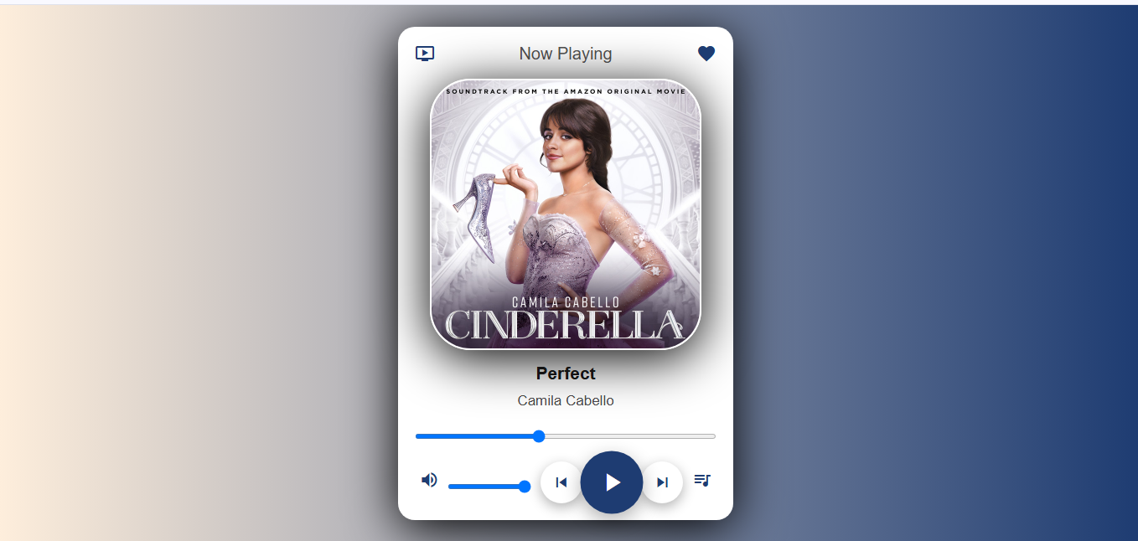
YouTube Integration showing the player interface with the YouTube icon and example video.

Slide 16
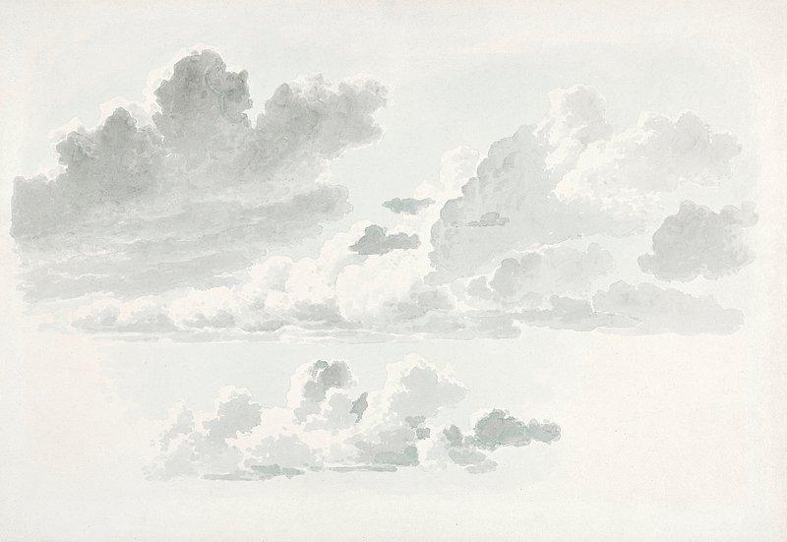
Conclusion
Enhanced User Experience: Our music player integrates dynamic album art, seamless song transitions, and a sleek design to offer an engaging and user-friendly interface.
Innovative Features: By adding bonus features like YouTube integration, automatic song switching and dynamic visuals, we elevated the standard music player functionality to create a more interactive and enjoyable experience.
Team Collaboration & Learning: This project helped us enhance our coding skills, work collaboratively, and better understand the fundamentals of front-end development.

Slide 17
Future Scope
Mobile app development for enhanced accessibility.
Offline playback support.
Advanced features like equalizers, playlist creation, and dark mode.

Slide 18

References/Links used
VS Code: Used for writing and editing code
vscode.dev
Google: Utilized for research and finding coding solutions.
google.com
Pinterest: Used for creative inspiration and design ideas
pinterest.com
YouTube: To link each song to its YouTube video
youtube.com
Pinterest: Used for creative inspiration and design ideas
pinterest.com

Slide 19


